Slide 1

iGTB Global Transaction Banking
26 April 2019
Contact : srinibas.panda@intellectdesign.com

Slide 2
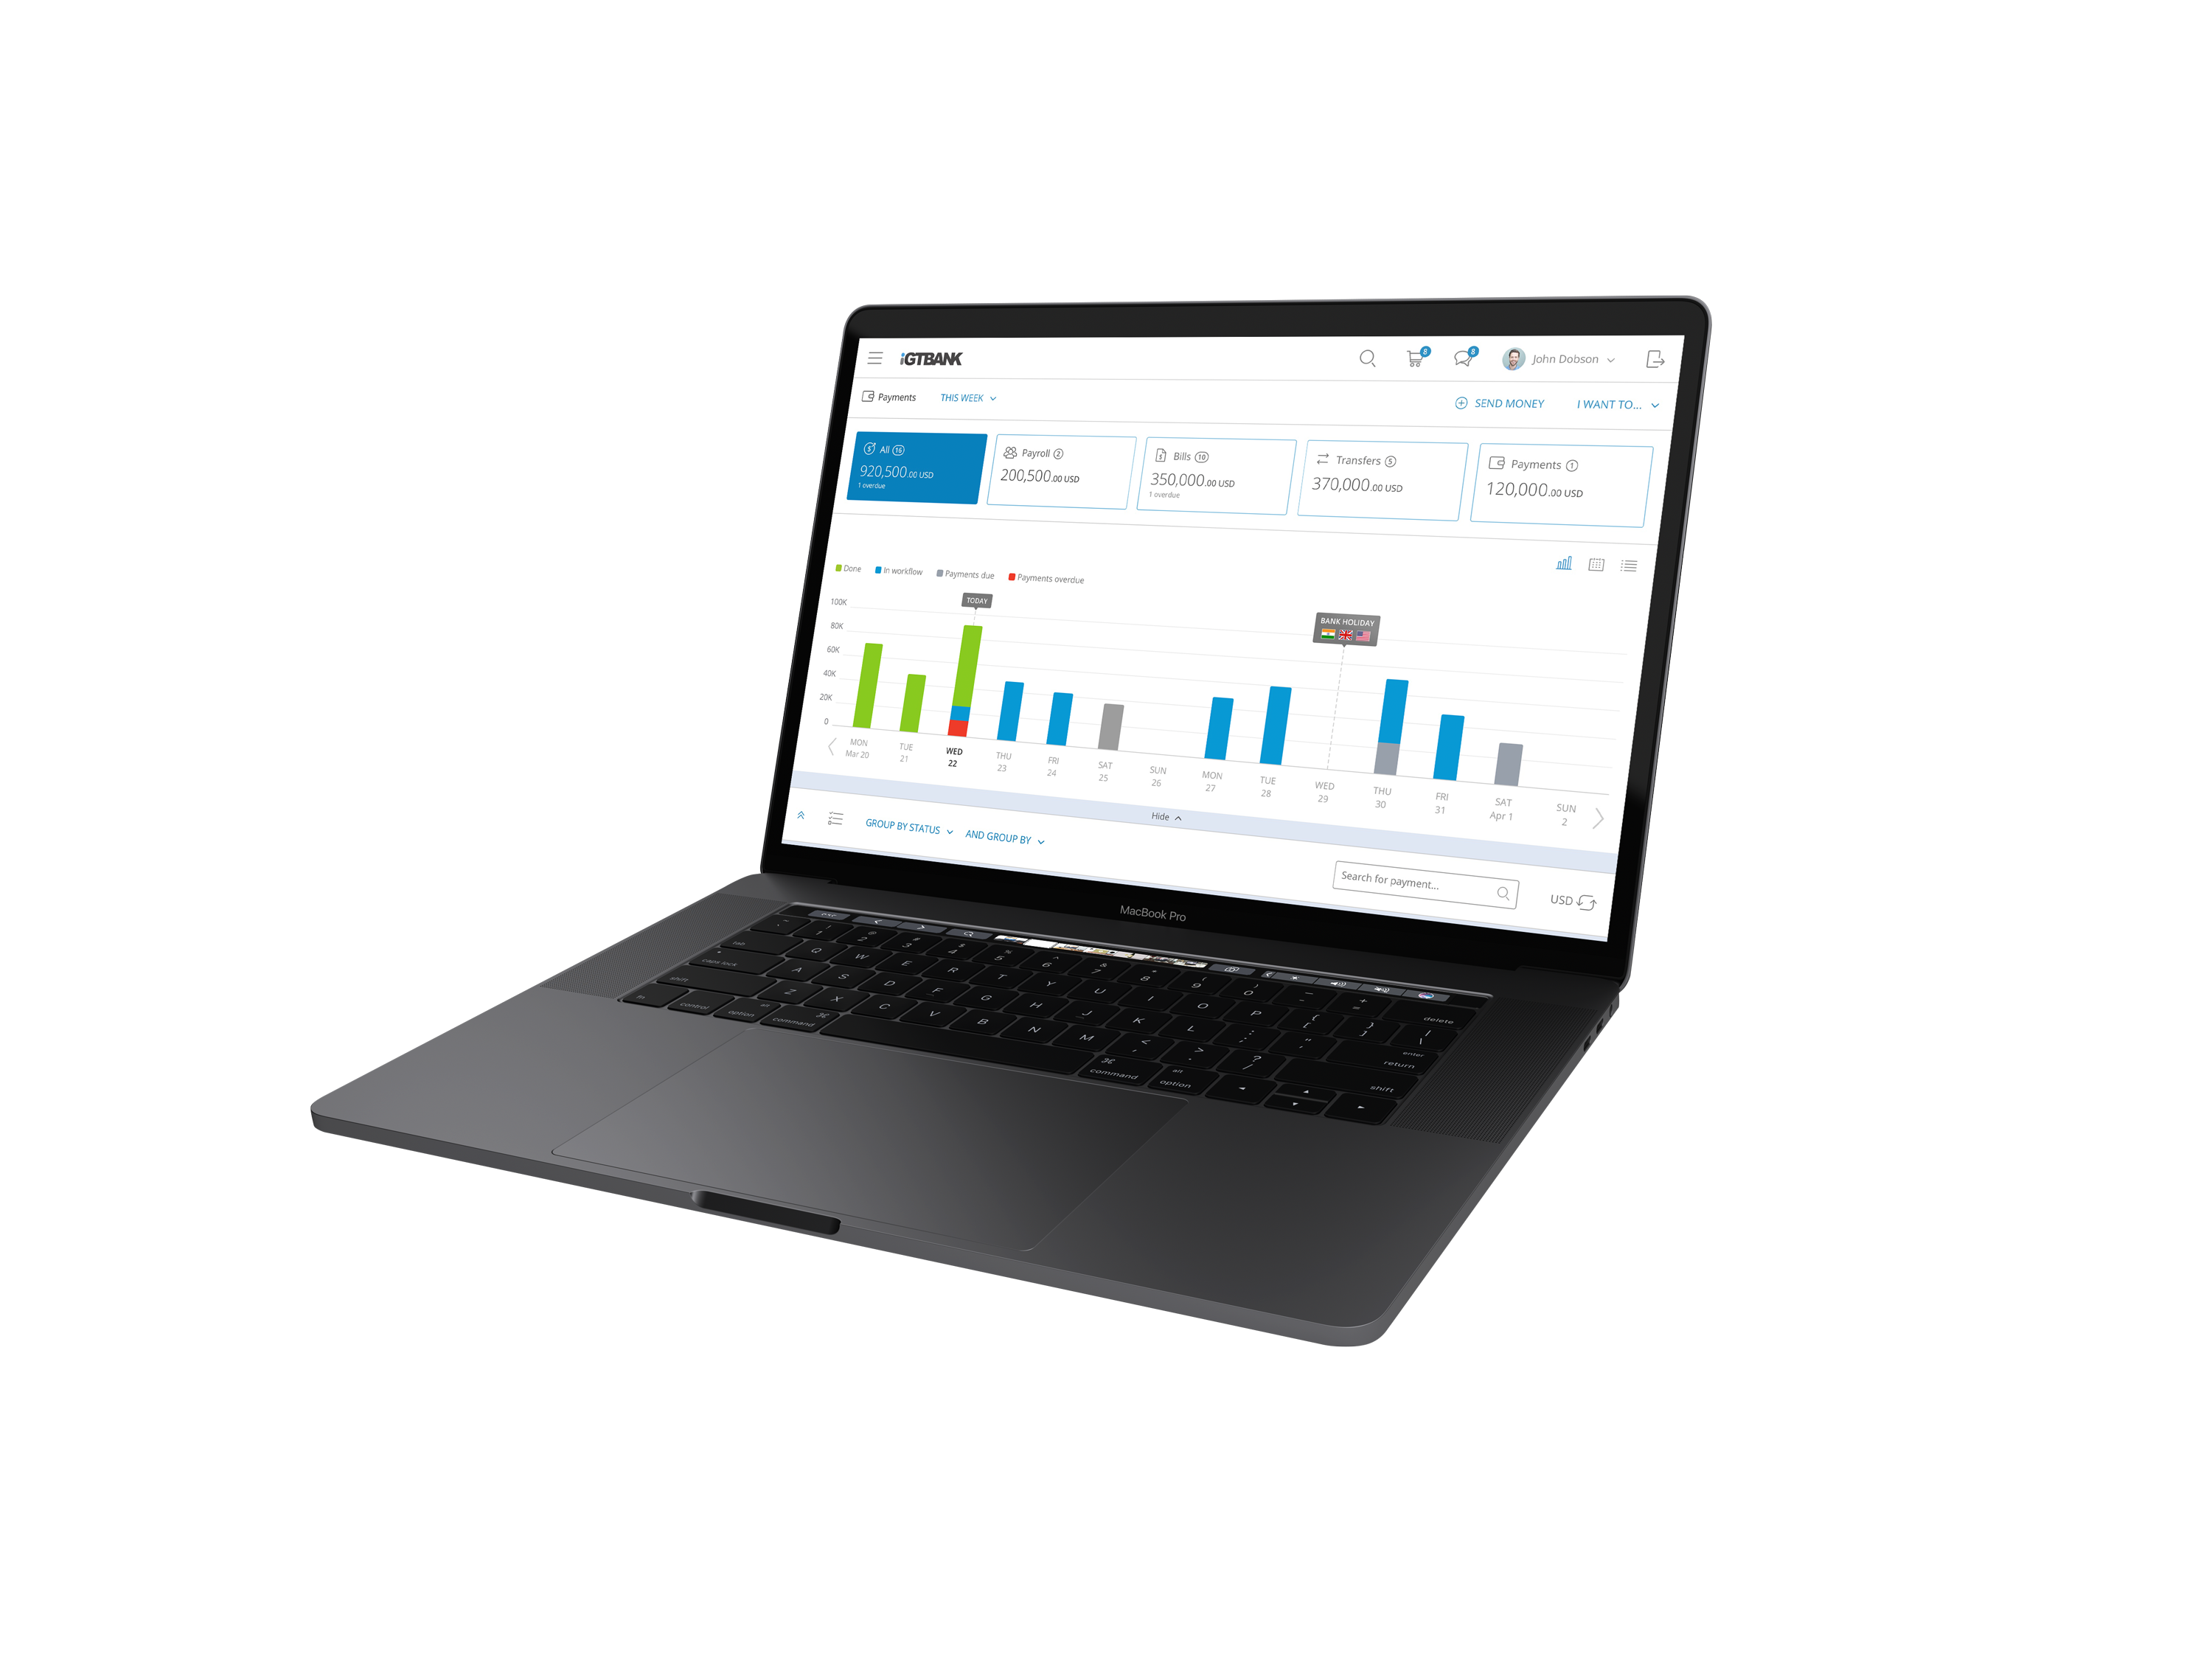
Mitsubishi UFJ Financial Group
iGTB -Overview and Demo

Slide 3

AGENDA | Topic | Duration
 | 1. Overview High level solution overview highlighting experience with implementation of online solutions for Cash Management Services in multiple countries Specific focus on : CMS, Cash Flow Forecasting, Netting, Forex, Reconciliation and Pooling | 00:10
 | 2. Demo : Cash Management Services Online portal Payments - Input / Template / File upload Workflow / Authorization Inquiries | 01:00
 | 3. Case study : Regulatory compliance and local laws Details of prior experience at the other banks, showing cost-effectiveness to meet the laws and regulatory requirements in terms of research, decision making, development, implementation and rollout. For example, PSD2 (Anomaly Detection, Open API), Malaysia RPP, Annual SWIFT Upgrade, Annual SEPA Upgrade Policy on upcoming regulatory requirements – For example, Target 2, CHAPS MX, BACS MX | 00:15
 | 4. Case study : Migration Case study showing successful migration of the Intellect solution | 00:15

Slide 4
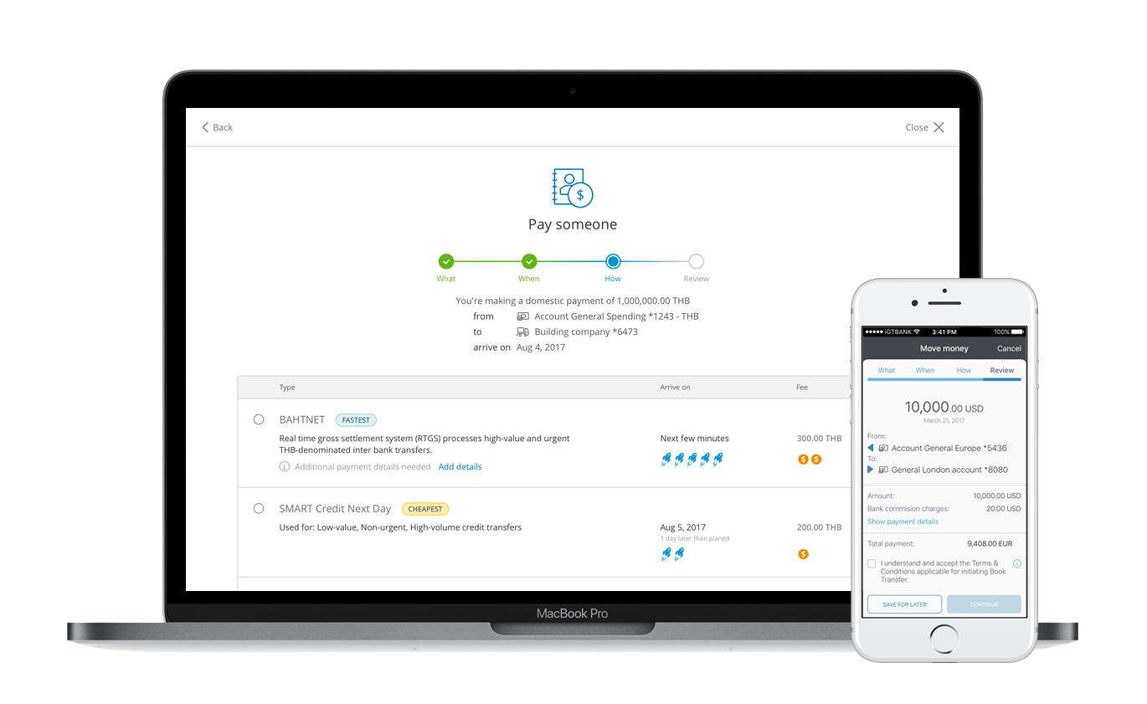
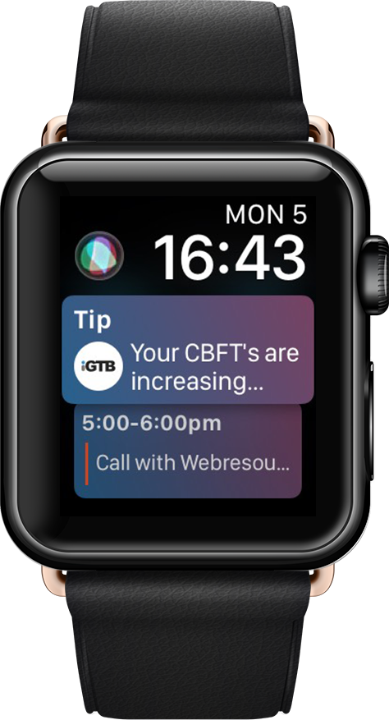

CBX: Intellect’s Contextual Banking Platform for Opti-Channel Delivery
Desktop, Tablet,
Responsive- and Native Mobile optimized
Contextual and Predictive
through machine learning
Deploy Anywhere:
Cloud Native &
On Premise
API first and
Micro Services based
Pluggable and
Extensible Architecture
World class UX and
Componentized UI for high
Self Service adoption.

Slide 5
Solution
Demo
Our solution demo today will broadly cover two key areas…
1
CBX (Contextual Banking eXperience) - Intellect’s digital banking solution for opti-channel delivery
Used by : Customers of your bank
2
iPSH (Intellect Payment Services Hub)
Used by : Payments operations team at your bank

Slide 6
Key considerations for a globally deployable and scalable architecture
Intellect’s payments architecture provides your bank with a cost-effective and efficient model that accelerates the ability to meet the various regional regulatory requirements with minimal to no dependency on us
Connectivity to inbound channels
Digital, File, Internet
File Transformation, Business Validations & Enrichment for corporate transactions
Channel Integration
SECURITY LAYER
Execution of all payment types
Payment Services Hub
Payment Execution
Workflow Manager
Messaging Engine
Rules Engine
Accounting
Foreign Exchange
Data Store
Data Initiation
Alerts & Advices
Risk Management
Intelligent Routing
Clearing Format
Library
Payment Decisioning
Clearings and Formats
Authorization logic across a corporate enterprise
Funds Verification
Limits
Stand-In Process
Network Resolution
Message Generation
Remittance data for payments
Payment Management
Remittance Repository
Operations, Compliance and Security
Audit
Queues
STP Validations
Data Storage
Data Retrieval
External Integration
Connectivity to payment networks, bank systems and clearing mechanisms

Slide 7



Key considerations for a globally deployable and scalable architecture
We leverage key architectural strengths that will help your bank support current needs and future scalability
1. Message Transformation
Ability to add new message structures or modify existing message structures
3. Business Process Workflows
Enable payment flow orchestrations across multiple systems for various payment types
2. Business Rules
Configure and rollout business rules without the need to modify code
4. Standard Interfaces
Ability to provide standard APIs for integration

Slide 8
Release methodology for upcoming regulatory changes
Structured mechanism to ensure adherence to upcoming regulatory changes
Ensure that your code is upgraded on a timely basis to reflect these changes
1
Upgrade methodology / frequency
The road map delivers in three (3) function categories
New and enhanced functional capability is delivered on a 18-24 month release cycle
New or enhanced technology is delivered in a functional release but on a 24-48 month release cycle
Code defect correction on a quarterly cycle
Regulatory and scheme mandates are delivered on a 12 month cycle (or as required by governing body)
2
Always upward compatible
New releases of the product are qualified with the latest versions of Oracle, WebLogic and WebSphere
e
Approach to data changes
Database modifications are supplied in the form of an upgrade and rollback script.
The upgrade script will make backups where needed and changes data structures. In case of issue, the rollback script provides the option to restore the structure and modified data to the previous state

Slide 9
Single Instance, Multi Country
iGTB Solution Components
Mashreq System
Product Processor
UAECore
CBX
FT Message Hub
(GTB Middleware)
Bank Middleware / ESB
CashCore
Account Services
Qatar Core
Corporate Users
Payments
Bahrain Core
Payment Services
Liquidity
Kuwait Core
Liquidity Services
SSO
Charges
Egypt Core
Collection & Receivable Services
Collection & Receivables
Qatar Treasury
Trade Services
Bahrain Treasury
Treasury Services
Kuwait Treasury
Egypt Treasury
ARX
( Integrated Security )
UAE Treasury
Bank Users
FX / SMS / Email / Black Shield System
External Interface
WPS
UAEFTS
QATCH
SWIFT
ICCS
Notes:
8
8
8

Slide 10
Payments – Application Architecture
Back Office Operations (UI)
Reference Data
Customer Onboarding
Workflow Setups
Rule Setups
Dashboards
Payment Inquiries
Exception Management
Security
Authentication
Authorization
Entitlements
Channels
Inbound Integrations
Payments Orchestration
Payments Engine
Outbound Integrations
Domestic Rails
Initiation
Enrichment & Validations
Enrichment & Validations
Workflows
H2H
Domestic Adapters
Files
Workflows
Exception &
Repair
Accounting
FX Handling
Bahtnet
Bahtnet
CBX - Portal
REST APIs
Smart
Smart
Branch
Handoff
Response & Reporting
Network Deriv. & Clg. Integration
Response & Reporting
Promptpay
Promptpay
Back Office
SOAP
Framework
Components
Same Bank
Workflow
Engine
Rule Engine
Transformation Engine
Payment Gateway
Queues
Common Services
Cross Border Adapters
Cross Border Rails
Other Bank Systems
Charges
Alerts
Advices
Reporting
SWIFT
SWIFT
Bank Systems
Integration
Queues
SOAP
REST APIs
Files
Bank Systems
CIF
Core Banking
Payment Engine
FX
Limits
Fraud & Compliance
Treasury
DWH

Slide 11
Our Portfolio of Products…
1
Intellect Digital Core – IDC 17.1
2
Intellect Digital Lending
3
Intellect Digital Credit card
4
Intellect Quantum Central Banking Solution
5
Contextual Banking Experience (CBX)
6
Contextual Payments
7
Liquidity
8
Trade and Supply
Chain Finance
9
Digital Transaction Banking
10
Digital Treasury
11
Digital Wealth
12
Capital Alpha
13
Xponent
14
Risk Analyst
15
Digital Distribution Suite

Slide 12










Americas/Europe
EXAMPLE CLIENTS
Integrated liquidity management
Sweeps, investment sweeps, pooling,
Inter company loans with corporate channel
USA + 42 Countries
Liquidity management
Sweeps, notional pooling, investment
sweeps, inter company loans
UK + 51 Countries
Liquidity management
UK
Americas / Europe
Liquidity Management
UK, USA
Liquidity management
Sweden + 4 Countries
Payments HUB for Spain and 12 countries
Liquidity management
Spain
Corporate payment decisioning
UK
Payments Services Hub
Canada
Integrated liquidity management with
corporate channel , sweeps, pooling,
inter company loans
Singapore + 9 Countries
Integrated collections & receivables
management
India
Integrated cash management (corporate
Channel with collections & receivables,
Payments, supply chain finance, liquidity,
Host to host connectivity)
Indonesia: partially live
Integrated cash management (corporate
Channel with collections& receivables,
Payments, supply chain finance,
Liquidity, host to host connectivity)
Malaysia
Asia Pacific
Trade and supply chain finance with corporate channel integrated
India
Integrated cash management with
corporate channel - payments, collections and receivables, supply chain finance
India
Integrated cash management &
corporate channel with collections
and receivables , payments
India
Integrated cash management with account services, payments, liquidity, collection & receivables with corporate channel
India
Some of our customers

Slide 13















EXAMPLE CLIENTS
Integrated cash management for payments, liquidity, H2H, collections & receivables with corporate/SME channel including trade.
UAE + 5 countries
Corporate channel with account services, payments, bulk payments
Qatar + 10 countries
Integrated cash management: account services , payments, collections / receivables, liquidity & corporate channel plus host to host
Saudi Arabia + 3 countries
Middle East
Integrated cash management for
Account services payments,
Liquidity: sweeps, pooling
UAE
Corporate channel with payments, liquidity, collections & host to host connectivity
Jordan + 12 countries
Corporate channel with payments & H2H
UAE
Corporate/ SME channel for salary upload and processing
Kuwait
Corporate channel for payments and trade
Qatar
Corporate channel with payments & trade
Qatar
Corporate channel with account services, payments & trade
UAE
Corporate channel with account services, trade, liquidity, payments
UAE
Cash management for
Account services payments
Kuwait
Africa
Integrated liquidity management with corporate channel, Sweeps, pooling, cash control
South Africa
Integrated cash management: account services, payments, liquidity, collections & receivables & corporate/SME channel
Kenya+ 4 countries
Integrated cash management: account services , payments, collections & receivables & corporate channel including trade
Tanzania+ 2 countries
Integrated cash management: account services , payments, & corporate channel including trade
Uganda
Some of our customers

Slide 14









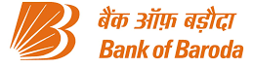








TRANSACTION BANKING RECENT MANDATES
Europe/Americas
Liquidity management front end
HSBC worldwide
Integrated trade finance
Austria
Liquidity Management
US
Liquidity management
Sweden + 4 Countries
Remittance Repository, Bulk e-payments, SWIFT Fin
Canada
Middle East/Africa
Integrated cash management for Account services, payments, liquidity: sweeps, pooling
UAE
Integrated cash management for account services payments, liquidity: sweeps, pooling
Bahrain and Kuwait
End to end integrated collections & receivables, liquidity
UAE
Integrated transaction banking for collections & receivables, liquidity, trade and SCF
Oman
Integrated cash management
for Account services, payments, receivables liquidity: sweeps, supply chain finance
Africa
CBX and Cash management
Africa
Integrated Cash management for
Account Services Payments,
Liquidity: Sweeps,Pooling
Malaysia
Trade and SCF solution
Inida
Trade and SCF solution
Solution for Westpac in emerging markets of APAC
Integrated Cash management for Account Services, Payments,
Liquidity: Sweeps,Pooling
Thailand + AEC
Digital Transaction Banking Corporate Portal
India
India / APAC
Digital Transaction Banking Platform
India
Liquidity Management
Australia
Front to back Liquidity Management Solution
Japan
Trade & Supply Chain Finance
Singapore
Digital Transaction Banking
Vietnam
Some of our customers

Slide 15

Designed by Intellect at 8012 FinTech Design Center
Design is at our very core.
Intellect is the ecosystem that nurtures and unlocks value in innovation
An evergreen start-up with the agility and hunger that fuels transformation and changes life for the better
Leverages design to attack complexity and unleash human potential
14

